Slide 1
Activation Functions

Slide 2

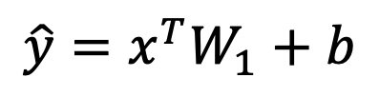
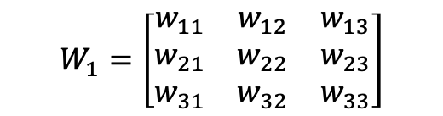
Why to use activation in NN?
$$W_{1}$$
$$W_{1}=\left[\begin{matrix}w_{11} & w_{12} & w_{13} \\ w_{21} & w_{22} & w_{23} \\ w_{31} & w_{32} & w_{33}\end{matrix}\right]$$
$$\hat{y}=x^{T}W_{1}+b$$

Slide 3
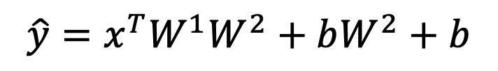



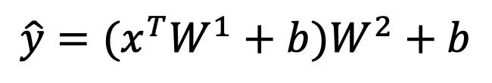

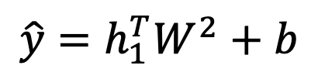
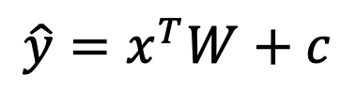
Why to use activation in NN?
$$W^{1}$$
$$W^{2}$$
$$h_{1}=x^{T}W^{1}+b$$
$$\hat{y}=h_{1}^{T}W^{2}+b$$
$$\hat{y}=(x^{T}W^{1}+b)W^{2}+b$$
$$\hat{y}=x^{T}W^{1}W^{2}+bW^{2}+b$$
$$\hat{y}=x^{T}W+c$$
Input
$$h_{1}$$
Output
Demo

Slide 4
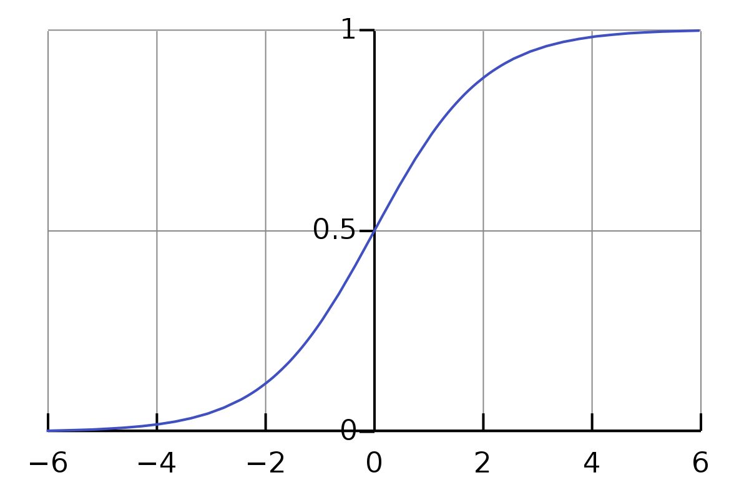
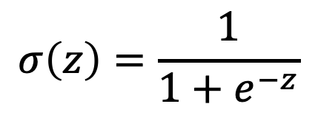
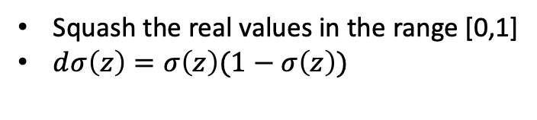
Sigmoid
Squash the real values in the range [0,1]
$ⅆσ\left(z\right)=σ\left(z\right)(1−σ\left(z\right))$
$$σ\left(z\right)=\frac{1}{1+e^{−z}}$$

Slide 5

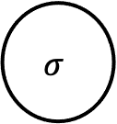

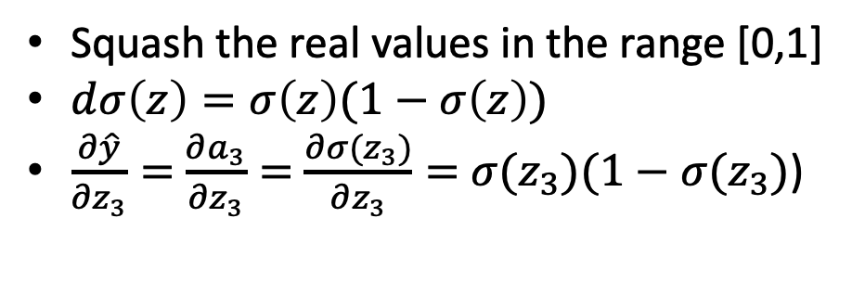

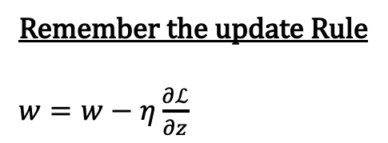
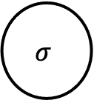
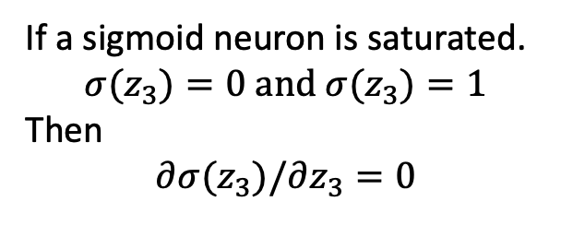
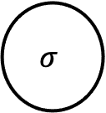
Sigmoid
Squash the real values in the range [0,1]
$ⅆσ\left(z\right)=σ\left(z\right)(1−σ\left(z\right))$
$\frac{∂\hat{y}}{∂z_{3}}=$ $\frac{∂a_{3}}{∂z_{3}}=$ $\frac{∂{σ(z}_{3})}{∂z_{3}}=$ ${σ(z}_{3})(1−{σ(z}_{3})$)
$$σ$$
$$a_{3}$$
$$z_{3}$$
If a sigmoid neuron is saturated.
$${σ(z}_{3})=0 and{ σ(z}_{3})=1$$
Then
$$∂{σ(z}_{3})/∂z_{3}=0$$
$$σ$$
$$a_{2}$$
$$z_{2}$$
$$σ$$
$$a_{1}$$
$$z_{1}$$
Remember the update Rule
$w=w−η\frac{∂ℒ}{∂z}$
x

Slide 6
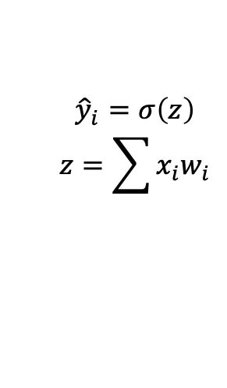
Why does a sigmoid neuron saturate?
$${\hat{y}}_{i}=σ\left(z\right)$$
$$z=\sum{x_{i}w_{i}}$$

Slide 7



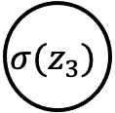

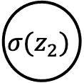


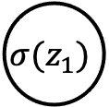
Problem with sigmoid
Gradient Vanishes in case of neuron saturate
Expensive to compute.
Not zero centered.
$$\hat{y}=a_{1}w_{1}+a_{2}w_{2}$$
$$∇w_{1}=\frac{∂ℒ}{∂\hat{y}}\frac{∂\hat{y}}{∂z_{3}}\frac{∂z_{3}}{∂w_{1}}$$
$$∇w_{2}=\frac{∂ℒ}{∂\hat{y}}\frac{∂\hat{y}}{∂z_{3}}\frac{∂z_{3}}{∂w_{2}}$$
$$x_{1}$$
$$σ(z_{1})$$
$$w_{1}$$
$$σ(z_{3})$$
$$x_{2}$$
$$σ(z_{2})$$
$$w_{2}$$
$\hat{y}={σ(a}_{1}w_{1}+a_{2}w_{2}$)

Slide 8
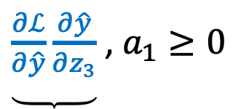
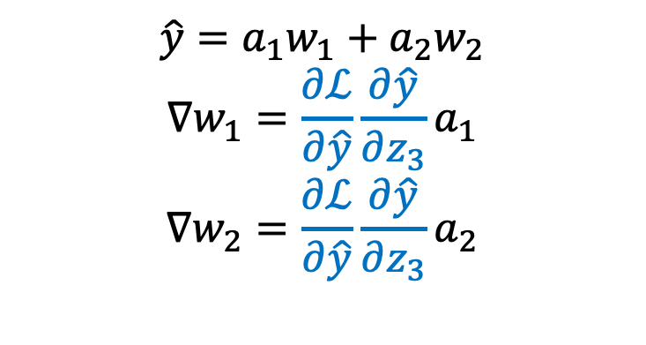
Problem with sigmoid
$$\hat{y}=a_{1}w_{1}+a_{2}w_{2}$$
$$∇w_{1}=\frac{∂ℒ}{∂\hat{y}}\frac{∂\hat{y}}{∂z_{3}}a_{1}$$
$$∇w_{2}=\frac{∂ℒ}{∂\hat{y}}\frac{∂\hat{y}}{∂z_{3}}a_{2}$$
$\underbrace{\frac{∂ℒ}{∂\hat{y}}\frac{∂\hat{y}}{∂z_{3}}}$ , $a_{1}≥0$
-VE or +VE
So Gradient of loss w. r.t all weights at a particular hidden layer are either +ve or –ve.
This restrict the possible update direction .

Slide 9
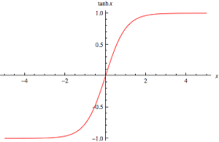
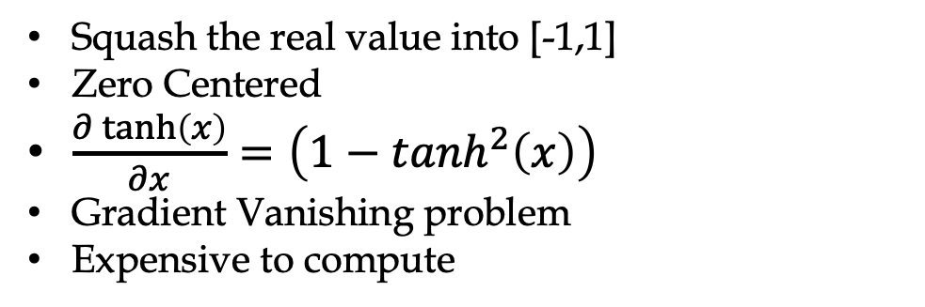
TanH
Squash the real value into [-1,1]
Zero Centered
$\frac{∂\tanh\left(x\right)}{∂x}=\left(1−\tanh^{2}\left(x\right)\right)$
Gradient Vanishing problem
Expensive to compute

Slide 10
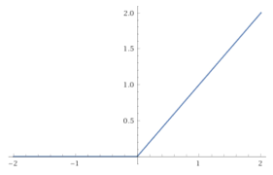

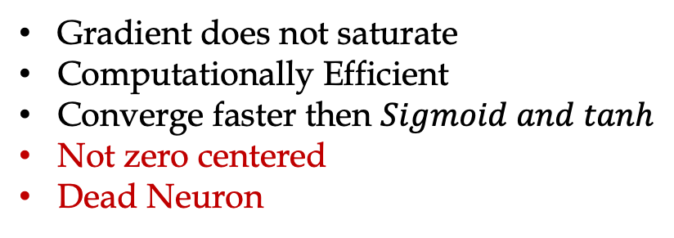
Relu
Gradient does not saturate
Computationally Efficient
Converge faster then $Sigmoid and tanh$
Not zero centered
Dead Neuron
$$relu\left(x\right)=max⁡(0,x)$$

Slide 11


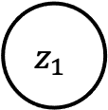
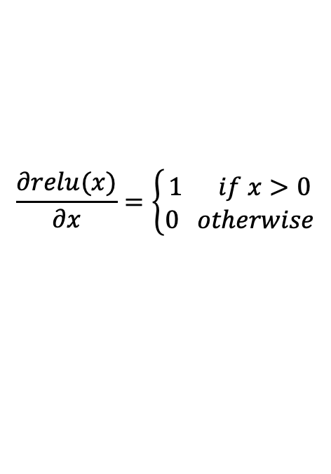
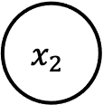
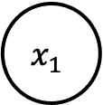

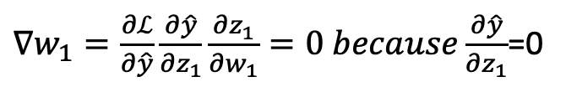

Dead Neuron
A Neuron is said to be dead if its weight are not
updated during the training
$$if x_{1}w_{1}+x_{2}w_{2}+b<0 because b< <0$$
$$x_{1}$$
$∇w_{1}=\frac{∂ℒ}{∂\hat{y}}\frac{∂\hat{y}}{∂z_{1}}\frac{∂z_{1}}{∂w_{1}}=0 because\frac{∂\hat{y}}{∂z_{1}}$=0
$$w_{1}$$
$$w_{ 2}$$
$$z_{1}$$
$$x_{2}$$
$\hat{y}={σ\left(z_{1}\right). where z_{1}=x}_{1}w_{1}+x_{2}w_{2}$+b
b
1
$$\frac{∂relu(x)}{∂x}=\left\{\begin{aligned}1 if x>0 \\ 0 otherwise\end{aligned}\right.$$
Remember: Large number of relu neuron dies during the
training if learning rate to too high.

Slide 12
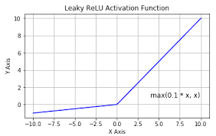

Leaky Relu
No saturation
No neuron dies problem
Computationally efficient
$$leaky relu\left(x\right)=max⁡(0.1∗x,x)$$

Slide 13
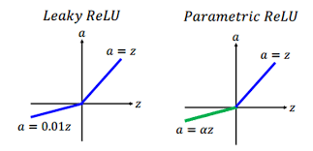

Parametric Relu
All benefits of Leaky relu
$$parametric relu\left(x\right)=max⁡(αx,x)$$

Slide 14
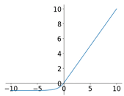
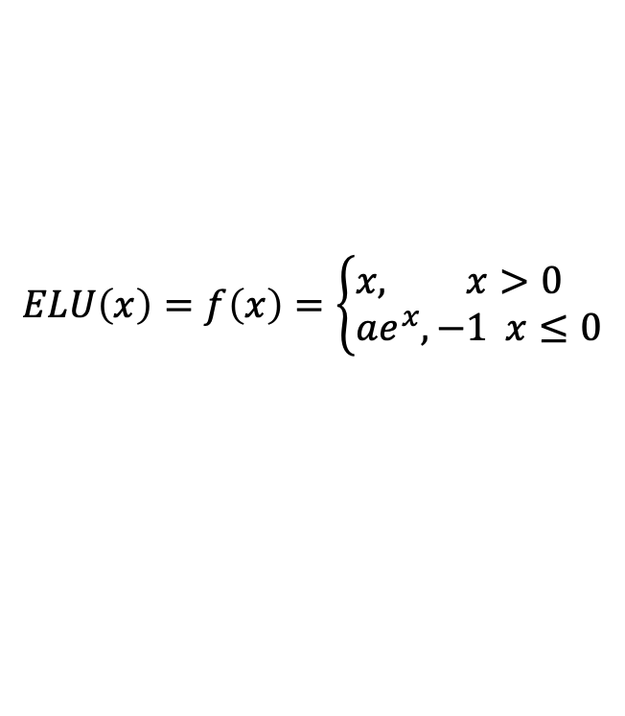
Exponential Relu
All benefits of Leaky relu
but expensive to compute
$$ELU\left(x\right)=f\left(x\right)=\left\{\begin{aligned}&x, x>0 \\ &ae^{x},−1 x≤0\end{aligned}\right.$$

Slide 15
Maxout activation
$$maxout\left(x\right)=max⁡(x^{T}w_{1}+b_{1},x^{T}w_{2}+b_{2})$$
No Saturation
No Dead neuron problem
Increase the number of parameters

Slide 16
Conclusion
Sigmoid and tanh suffer from the gradient vanishing problem(don’t use in case of deep network)
Relu is the most popular activation but it can lead to Dead neuron problem.
Variants of relu requires careful tuning of the hyperparameters.

